Slide 1
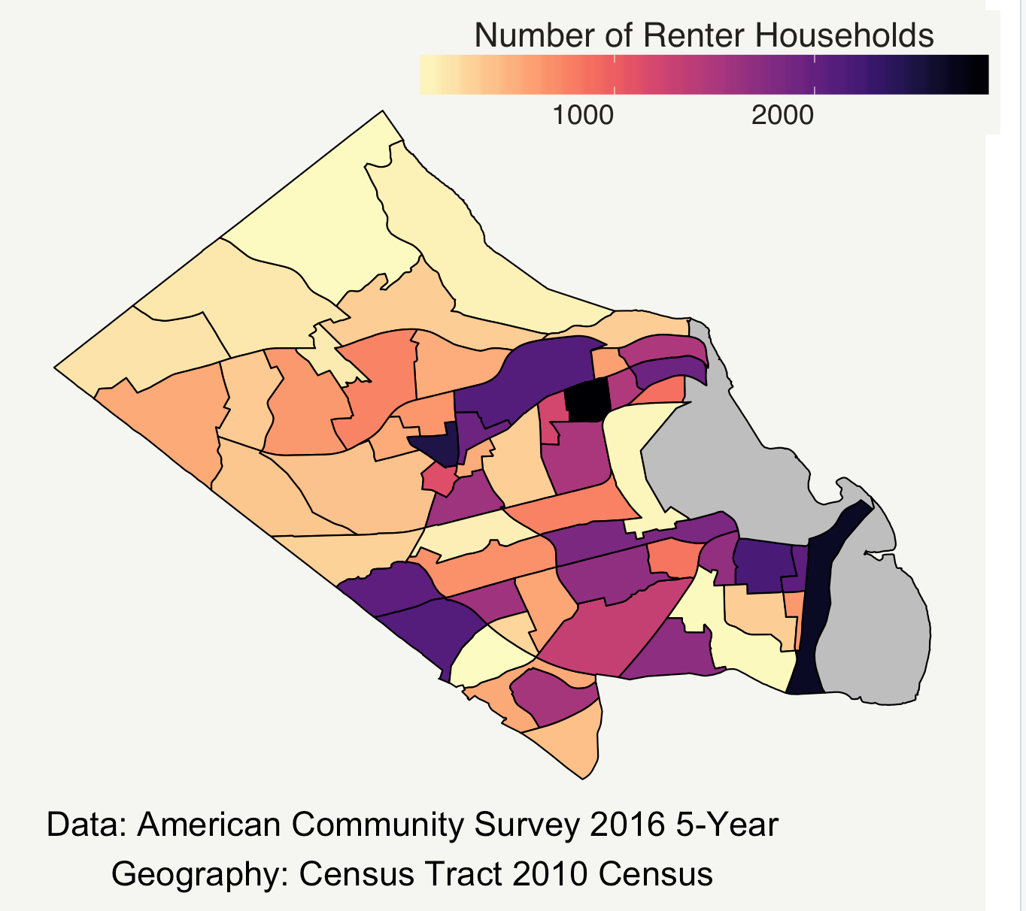

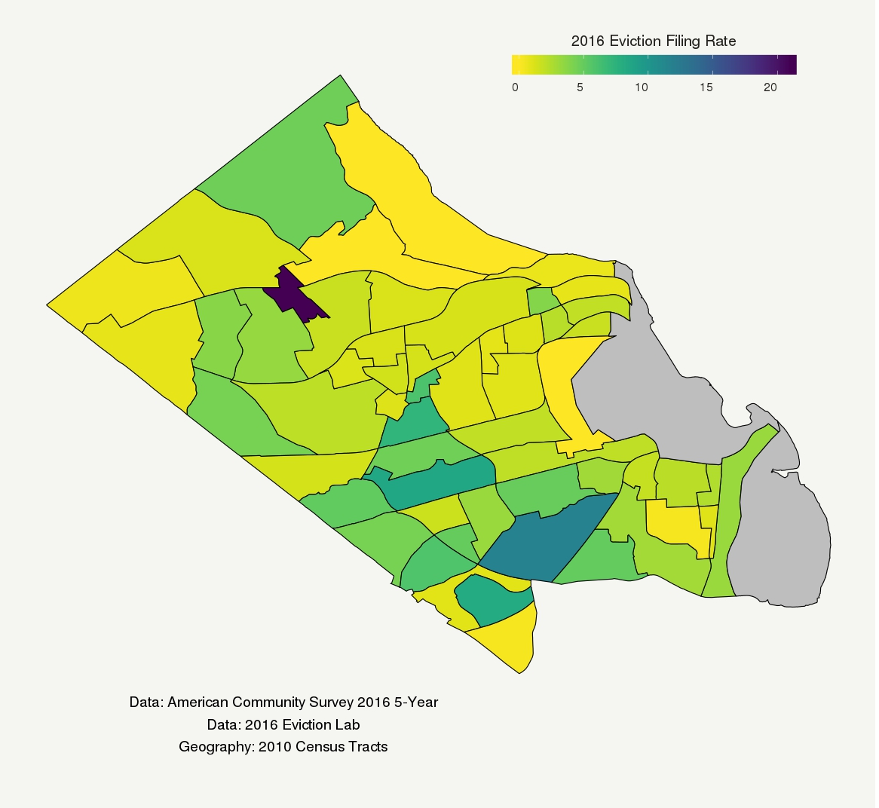
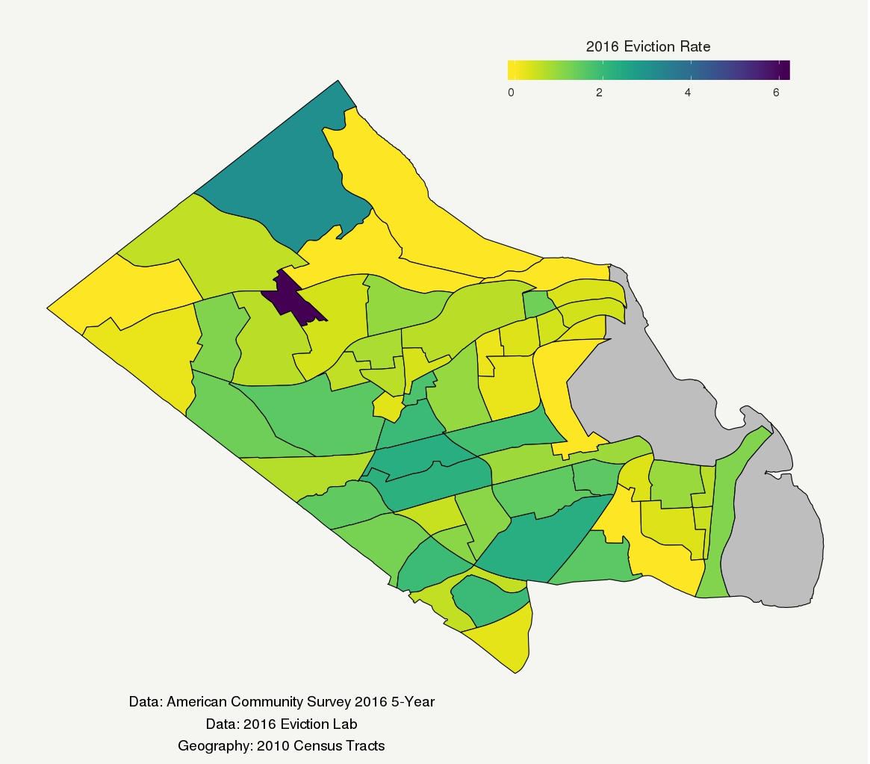
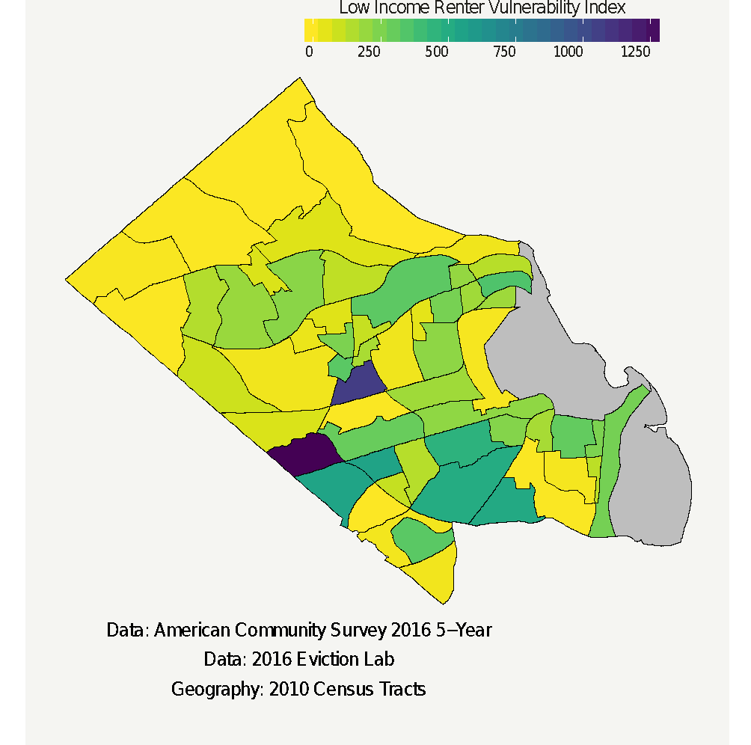
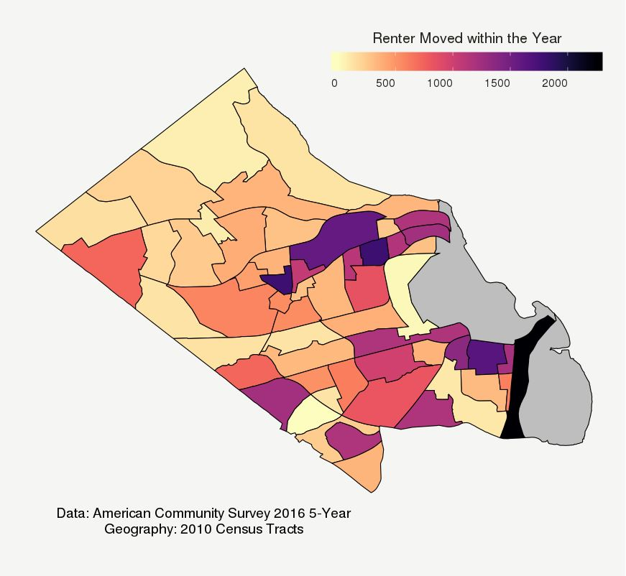
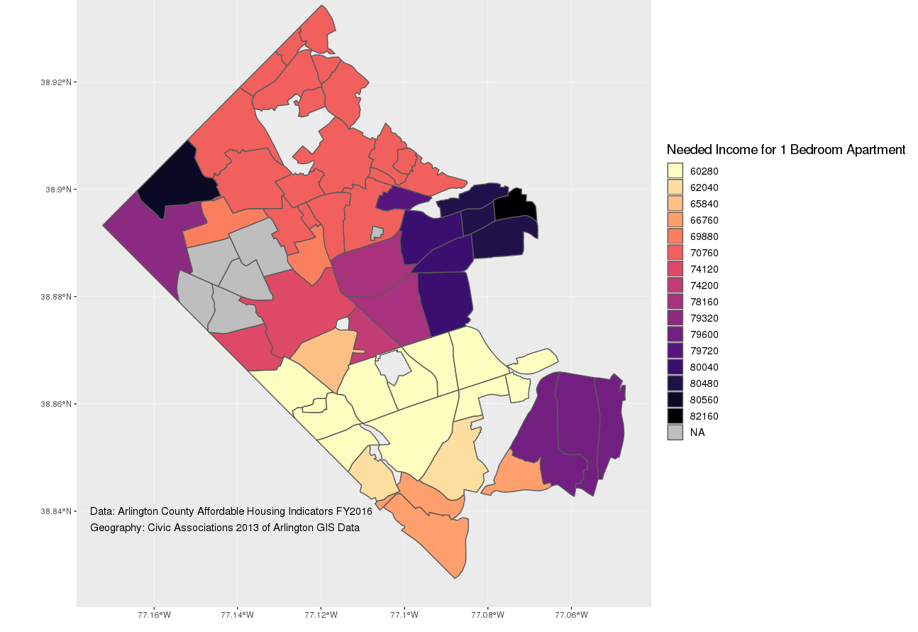
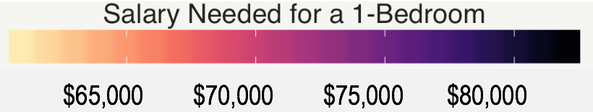

Building a More Equitable Arlington: Baseline
Characterizations of Renter Households & Apartment Stock
Fellow Davon Woodard, Students Armi Mosavian and Weerasu Warajuntano
Arlington Community Progress Network (CPN): Nathanial Root, Jose Quinonez, and Cheryl Ramp
Project Objectives
Arlington County
2016 Renter Population Demographics
The Community Progress Network (CPN) is an Arlington County advisory council of
civic and business leaders, elected officials, service providers, nonprofits, and research institutions including the Social Decision and Analytics Lab. The mission of CPN is to promote equity through education, engagement, and advocacy.
This project contributes to the mission of CPN by constructing baseline characterizations of renter family and non-family households and the apartment stock. These analyses can be used to inform policy on affordable housing needs and to educate Arlington County residents as to the plight of low income rental households.
There were 56,176 or 50.7% renter occupied households.
The median household income for the past 12 months (in 2016 inflation-adjusted dollars) was $84,585 per year ± 2,482 (margin of error).
There were 10,336 ± 575 (margin of error) households with no vehicle.
There were 7,045 ± 422 (margin of error) Black or African American heads of households.
There were 7,904 ± 492 (margin of error) Hispanic or Latino heads of households.
Figure 1. Location of the Number of Family & non-Family Renter Households in Arlington County, Virginia.
Vulnerable Low Income ($35,000/year)
Renter Households
2016 Eviction Filing Rates versus Eviction Rates
A composite index was constructed to identify vulnerable low income renter households at the census tract level. Indicators that were used to construct the composite index include:
Low income housing burden: households that spend > 30% of their income on housing where their household income < $35,000 per year (~30% of the area median income of $108,000 per year) (ACS 5-year estimates 2012-2016)
Eviction Filings: a landlord files a case in court to have the tenant removed from the property (2016 Eviction Lab)
Crowding: ≥ 1.51 occupants per room (ACS 5-year estimates 2012-2016)
A “filing rate” is the ratio of the number of evictions filed in an area over the number of renter-occupied homes in that area. An “eviction rate” is the subset of those homes that received an eviction judgement in which renters were ordered to leave. The filing rate also counts all eviction cases filed in an area, including multiple cases filed against the same address in the same year. But an eviction rate only counts a single address who received an eviction judgement (Definition from EvictionLab.org).
It is interesting to note that the census tract with the highest filing and eviction rates, 1008.00, had only 148 ± 30 (margin of error) rental households in 2016. The census tract with the second highest eviction rate, 1003.00, had only 65 ± 31 (margin of error) rental households in 2016.
Figure 2. The most vulnerable renter households are located in the Arlington Mill, Buckingham, and Forest Glen neighborhoods. Within these two census tracts (1022.00 and 1020.03) there were approximately 2,608 ± 325 (margin of error) renter households in 2016; of these, the number that were low income (≤ $35,000 per year) and housing burdened were 2,077 ± 355 (margin of error). There were 217 eviction filings within these two census tracts in 2016. These two census tracts are statistically different from the other 57 census tracts within Arlington as defined by the CENSUS statistical difference calculator (http://www.census.gov/programs-surveys/acs/guidance/comparing-acs-data.html).
Figure 3. Eviction Filing rates were generally low, however, certain census tracts were hotspots for filings rates, such as tracts 1008 and 1031. Filing rates are higher as compared to evictions rates, as can be seen in Figure 4.
Despite the high filing rates, most of the filings did not go through to become an eviction rate, as can be seen through the decrease in numbers across the two geo-plots.
Figure 4. Compared to the filing rates, the rate of actual evictions is lower. Most census tracts in Arlington County have little to no eviction rates,. However, census tract 1008 (similar to the filing rates) had the overall highest eviction rate, at 6 evictions total, with census tract 1003 following behind with 4 total evictions. Demographically speaking, neither of the census tracts mention (1008 or 1003) are that different from those in the same area of northern Arlington, and as such, cannot be accounted for their high rate of evictions.
2016 Renter Instability
Rental Affordability and Stock
References/Acknowledgements
For low-income households, “renter mobility,” changes in residences, can be associated with multiple, interacting factors including housing cost (burden), rental availability, family composition changes, immediate prior evictions, quality and quantity of housing stock.^{1,2,3}
Each neighborhood in Arlington County has its own average price for renting an apartment. The “rental affordability” is the income needed so that no more than 30% of a household's yearly income is spent on housing. The average price for a 1-bedroom in Arlington Mill is $1,507 and the average price for a 1-bedroom in North Rosslyn is $2,054.
Boggess, L. N., & Hipp, J. R. (2010). Violent crime, residential instability and mobility: Does the relationship differ in minority neighborhoods?. Journal of Quantitative Criminology, 26(3), 351-370.
Desmond, M., & Perkins, K. L. (2016). Housing and household instability. Urban Affairs Review, 52(3), 421-436.
Coulton, C., Theodos, B., & Turner, M. A. (2012). Residential mobility and neighborhood change: Real neighborhoods under the microscope. Cityscape, 55-89.
RentCafe. Yardi System, www.rentcafe.com/1-bedroom-apartments-for-rent/us/va/arlington/. Accessed 27 July 2018.
RStudio Team (2016). RStudio: Integrated Development for R. RStudio, Inc., Boston, MA URL http://www.rstudio.com/.
Figure 5. 2016 Renter Mobility in the previous 12 months in Arlington County, Virginia.
Figure 6. Income needed to rent an one bedroom apartment where the amount spent on the apartment is no ore than 30% of the renters yearly income For example,, in the Nauck neighborhood, the average rent for a 1-bedroom apartment is $1,551 per month⁴. So people who live in the Nauck neighborhood must make at least $62,040 per year not to be house burdened,.
Stay Connected:
facebook.com/biocomplexity
twitter.com/biocomplexityvt
youtube.com/c/biocomplexity
google.com/+biocomplexity
Notes:
GENERAL RULES TO FOLLOW:
Stay in Google Slides to work on your poster because it:
provides a template with all the approved branding including colors, fonts, and logo placement/usage;
allows you to collaborate with others;
helps you to communicate with your fellow researchers, lab./dept., and creative services;
Editing this file:

